Slide 1

What Mr. Spock would possibly say about modern unit testing: pragmatic and emotional overview
Yaroslav Yermilov
Senior Software Engineer, EPAM Systems

Slide 2


About me
Yaroslav Yermilov
Senior Software Engineer, postgraduate
https://ua.linkedin.com/pub/yaroslav-yermilov/58/682/506
https://www.facebook.com/yaroslav.yermilov
https://twitter.com/yermilov17
fond of Java, complete code, big data, data science, Groovy

Slide 3
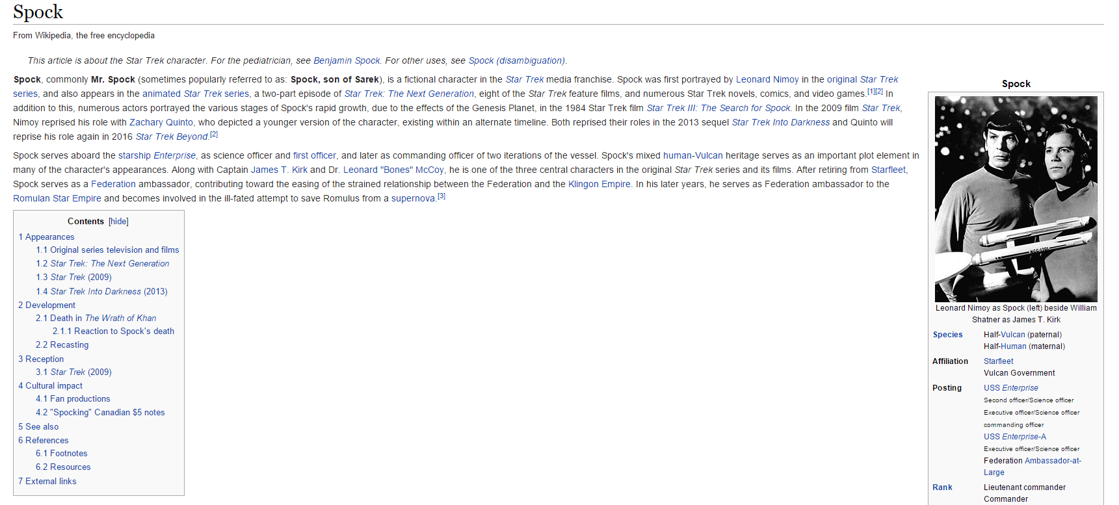
About Spock

Slide 4

disclaimer

Slide 5
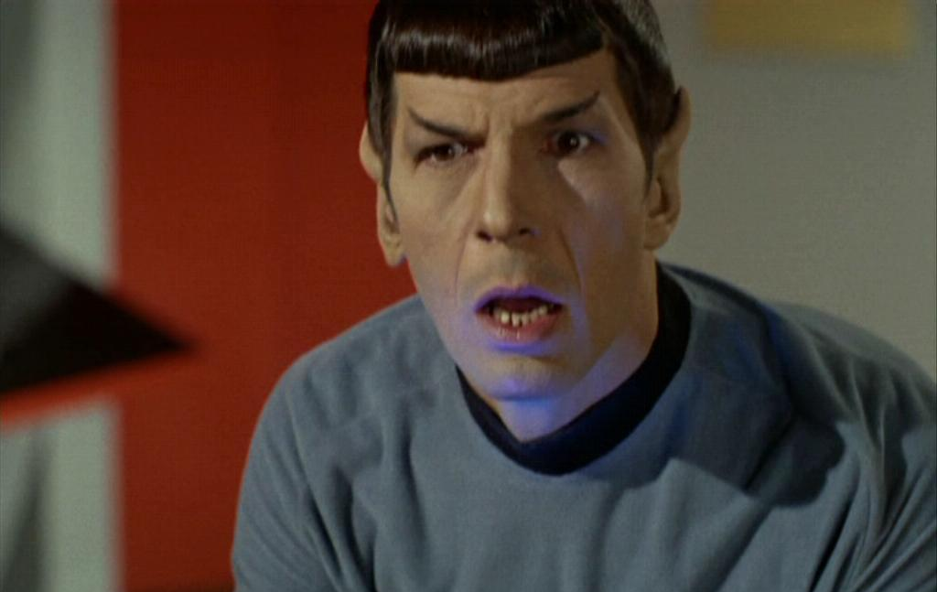
What’s the problem?

Slide 6

Better to test before going to production

Slide 7
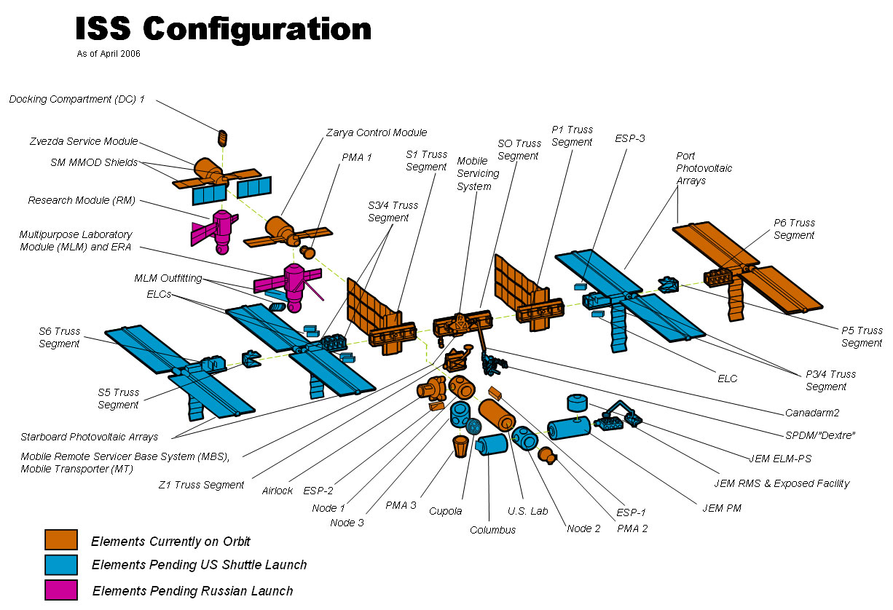
Firstly, to unit-test

Slide 8
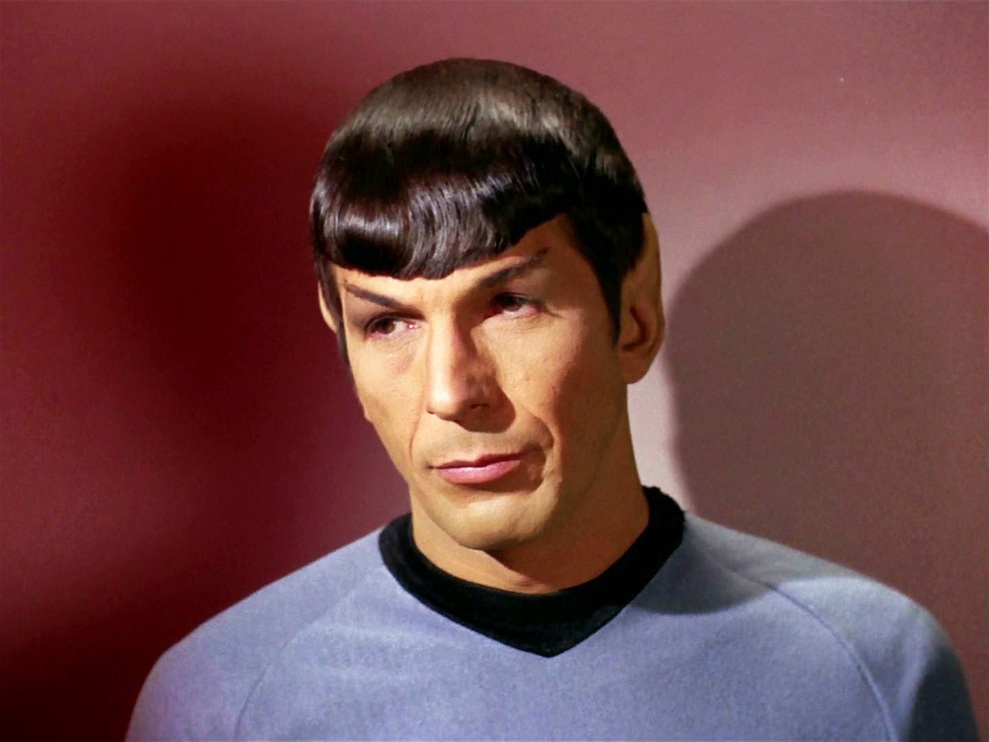
So what?

Slide 9

JUnit?

Slide 10

JUnit on steroids?

Slide 11

TestNG?

Slide 12
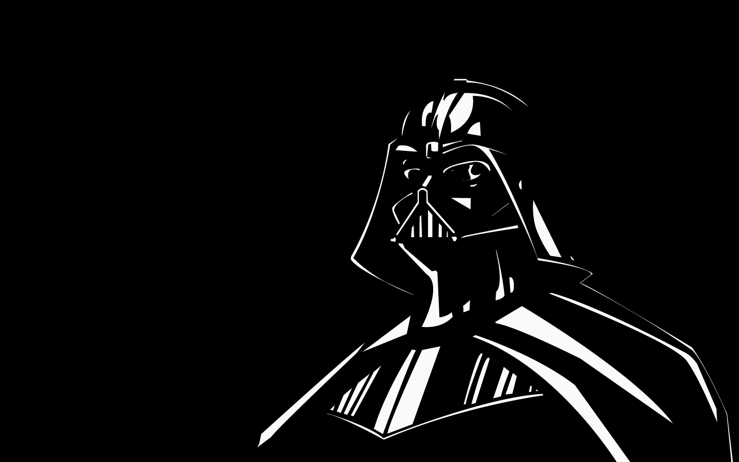
Nothing?

Slide 13

Well, JUnit is great

Slide 14

But a little bit...

Slide 15
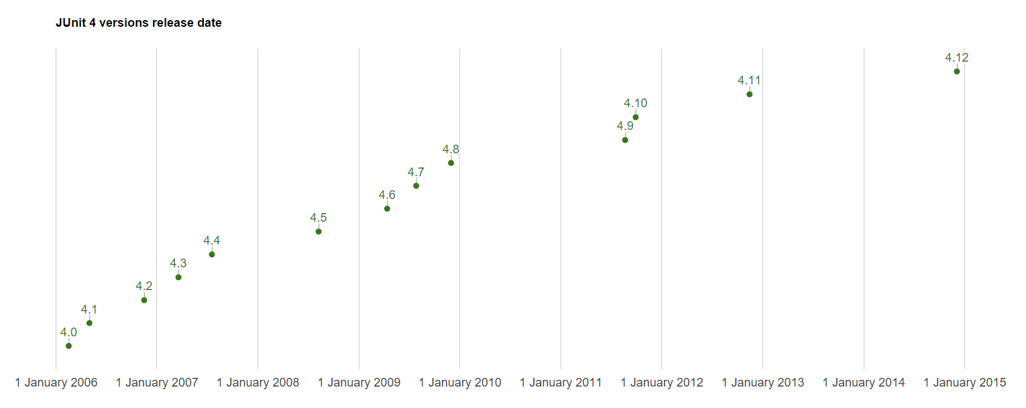
...stable?

Slide 16

So why don’t try Spock?

Slide 17
Why Groovy?
Groovy is the Java re-imagined
Have your ever think how Java 2.0 should look like?
Groovy has lots of features you even don’t think about, but after first taste you won’t be able to imagine development without them
Groovy is fully compatible with Java
Groovy has beautiful and highly expressive DSLs

Slide 18

Spock
Why Groovy?
Spock
JUnit
Groovy is the Java re-imagined
JUnit 5.0
Have your ever think how Java 2.0 should look like?
Spock
Groovy has lots of features you even don’t think about, but after first taste you won’t be able to imagine development without them
unit-testing
Spock
Groovy is fully compatible with Java
Spock
Groovy has beautiful and highly expressive DSLs

Slide 19
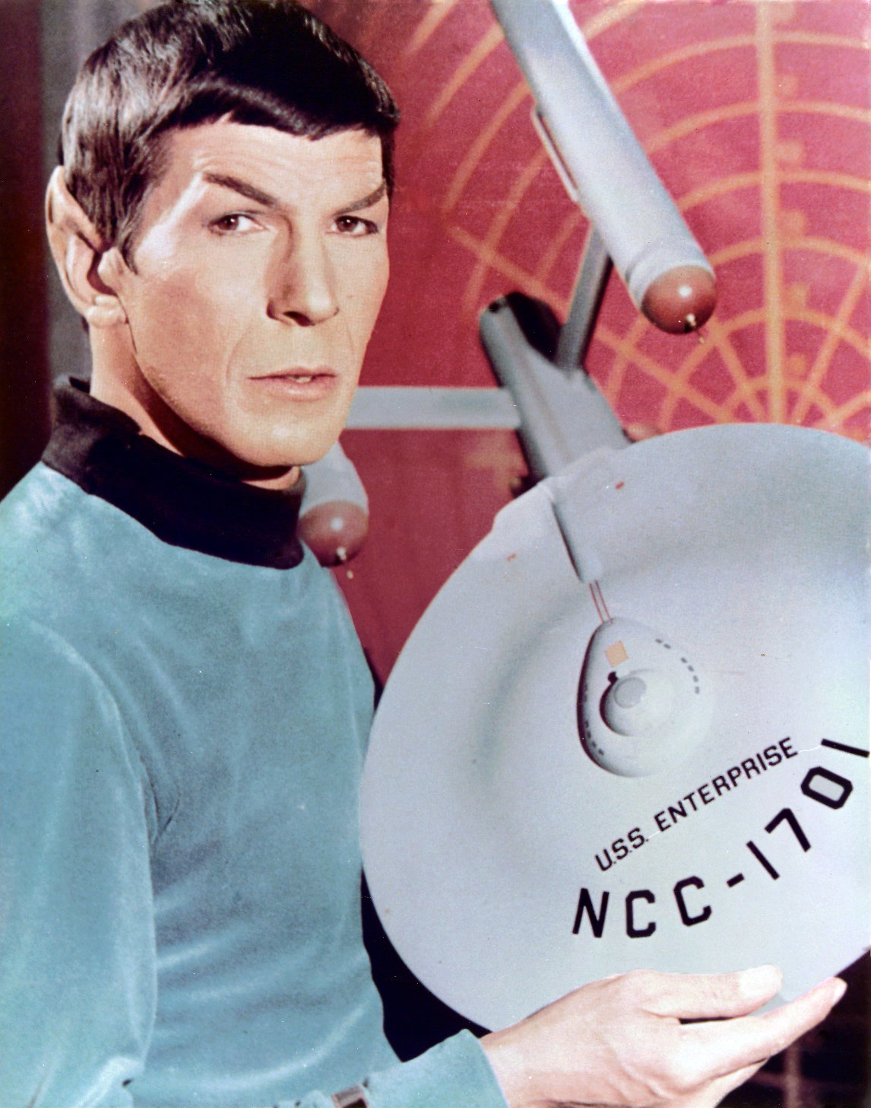
Spock is Enterprise ready

Slide 20
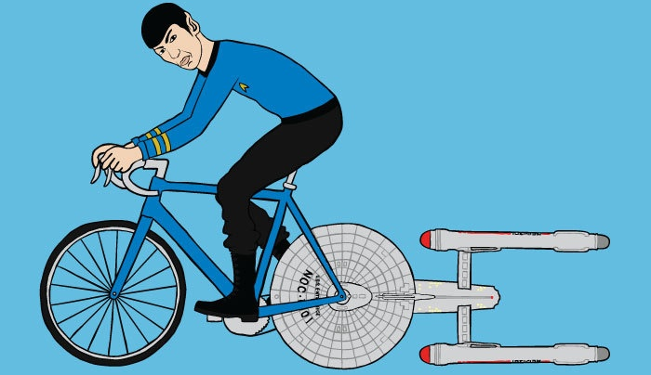
Let’s go!
https://github.com/yermilov/spock-talk

Slide 21
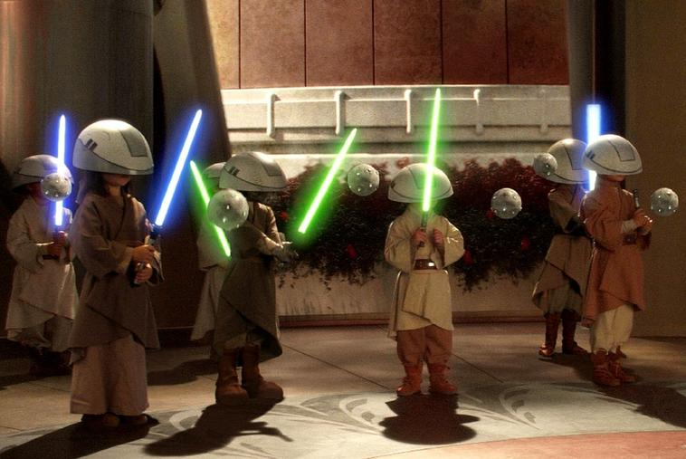
Episode I: Every journey starts somewhere

Slide 22
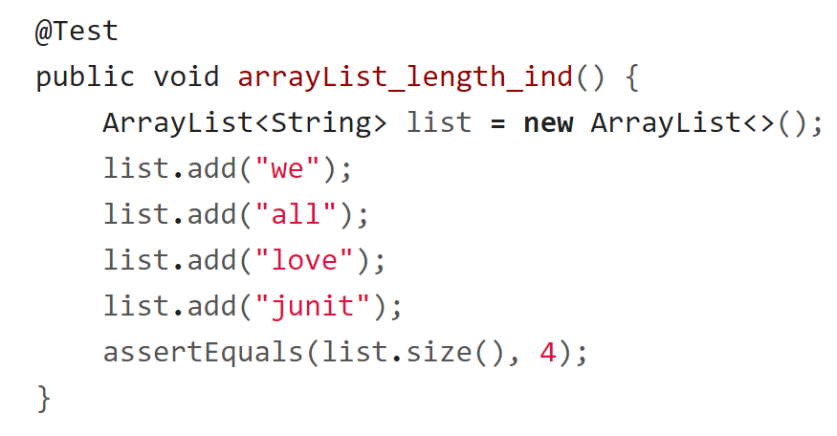
Episode I: Every journey starts somewhere

Slide 23
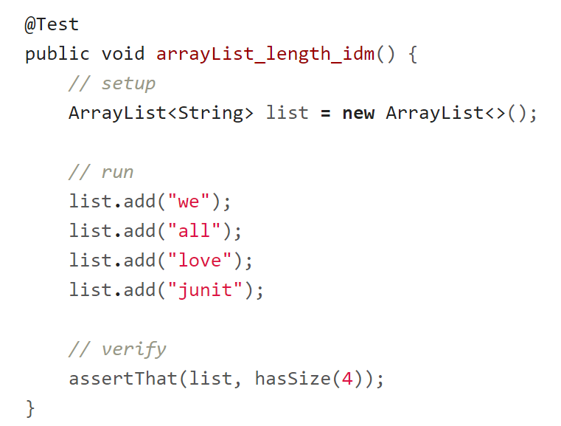
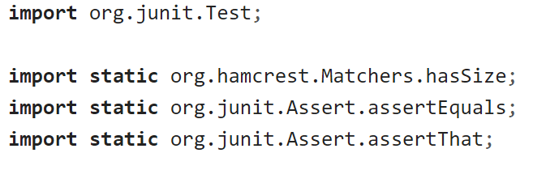
Episode I: Every journey starts somewhere

Slide 24
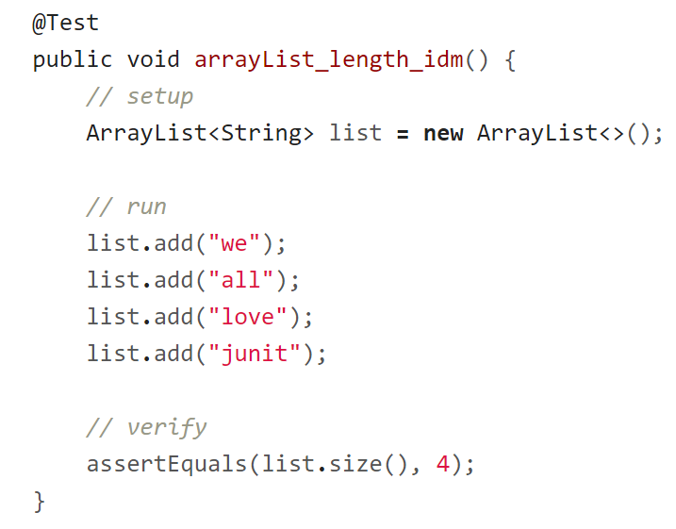
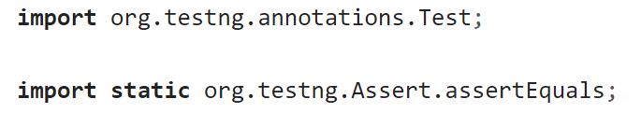
Episode I: Every journey starts somewhere

Slide 25

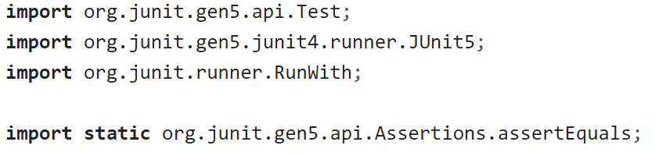
Episode I: Every journey starts somewhere

Slide 26
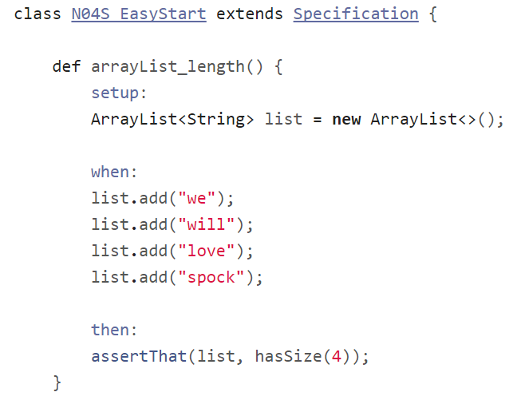
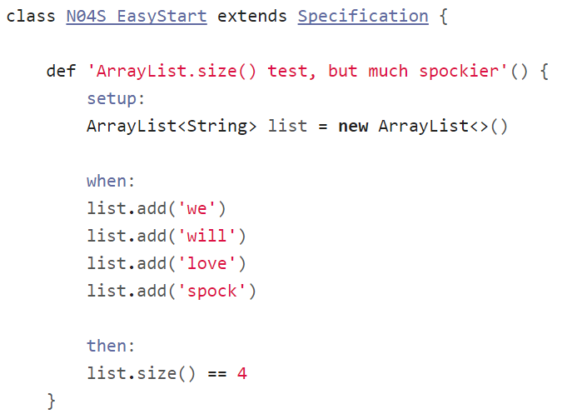
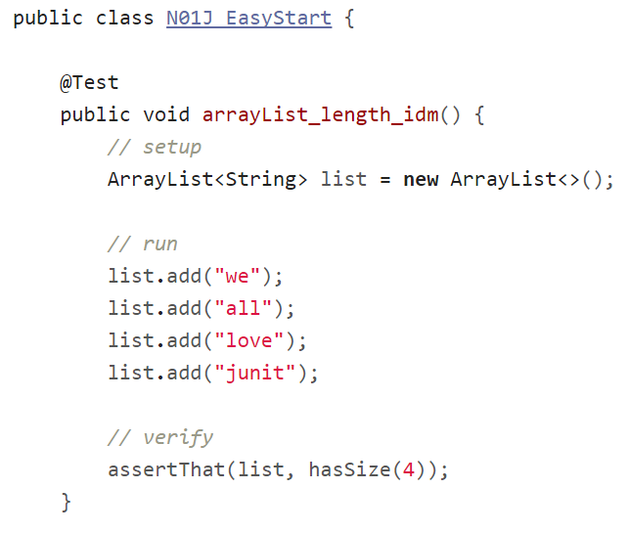
Every journey starts somewhere

Slide 27
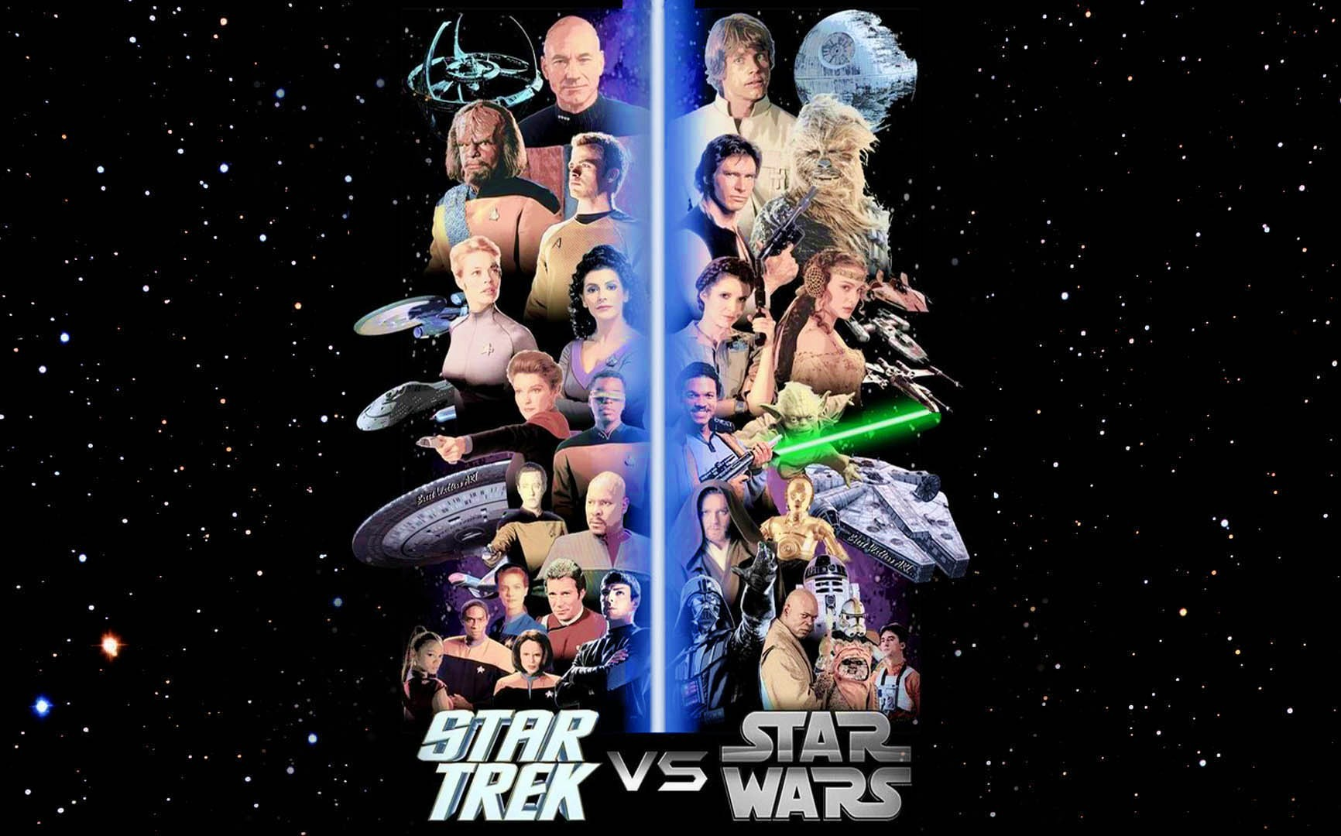
Episode II:
Assertions

Slide 28
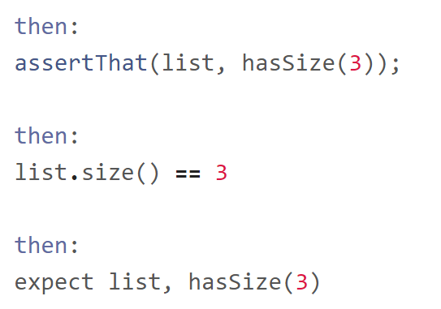
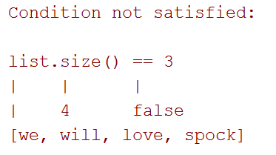
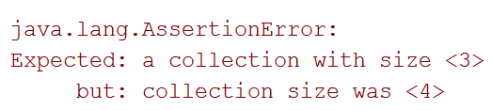
Episode II: Assertions

Slide 29
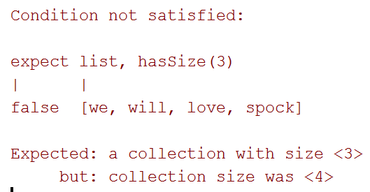
Episode II: Assertions

Slide 30
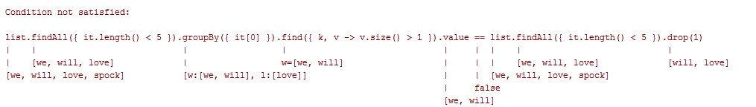
Episode II: Assertions

Slide 31
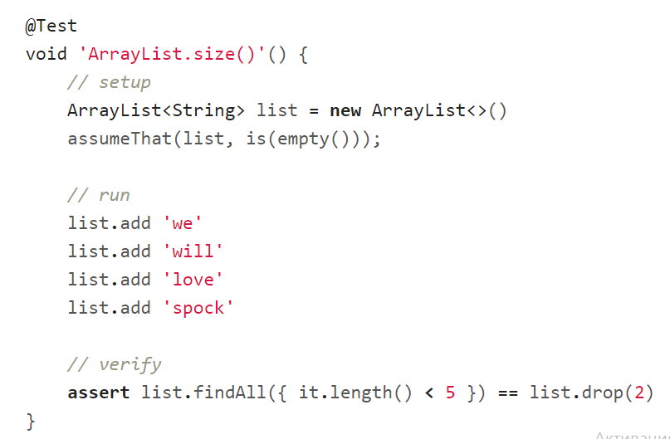
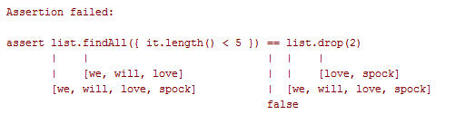
Episode II: Assertions

Slide 32
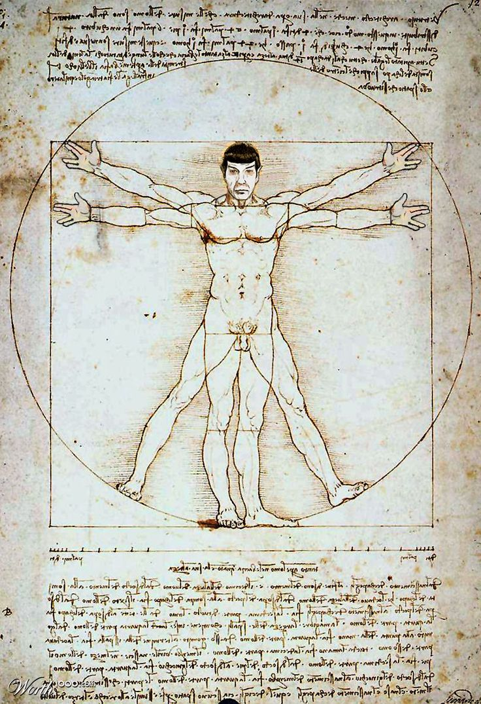
Episode III: Idiomatic Spock

Slide 33
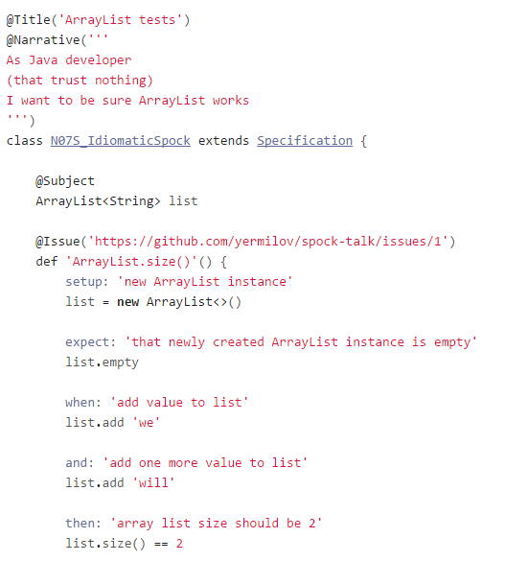
Episode III:
Idiomatic Spock

Slide 34
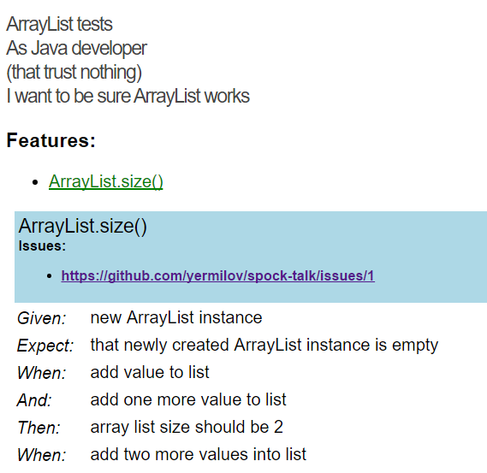
Episode III:
Idiomatic Spock

Slide 35
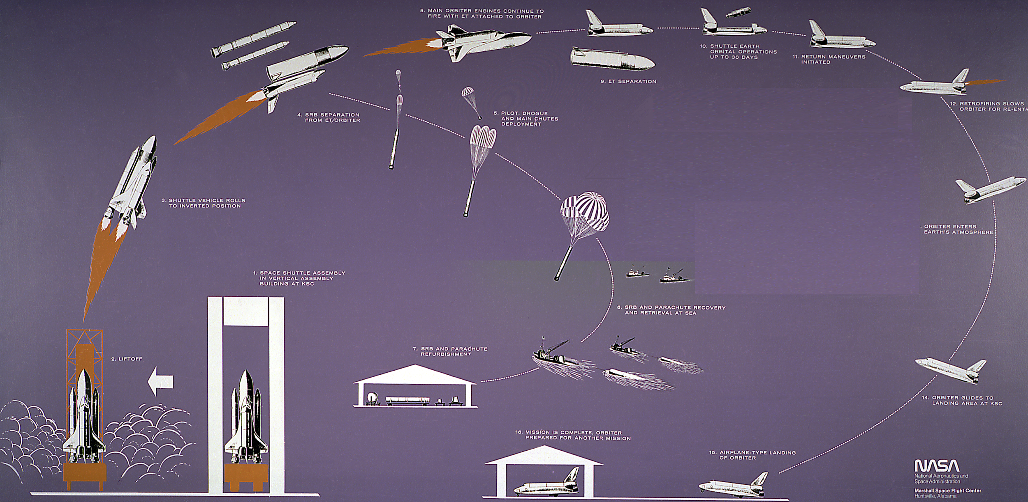
Episode IV:
Setup/Teardown

Slide 36
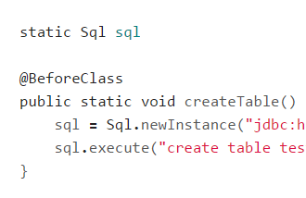
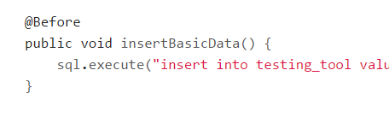
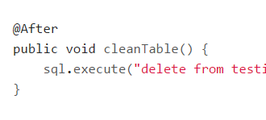
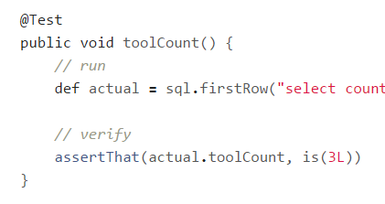
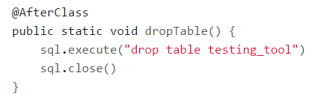
Episode IV: Setup/Teardown

Slide 37
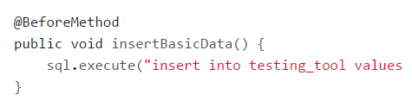
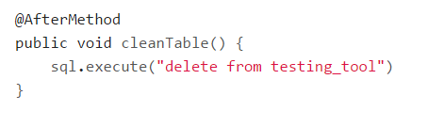
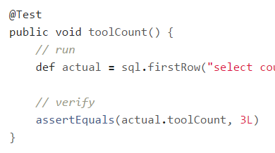
Episode IV: Setup/Teardown

Slide 38
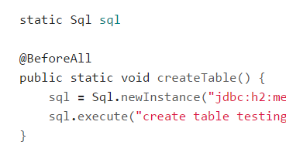
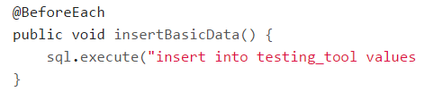
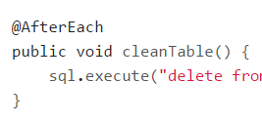
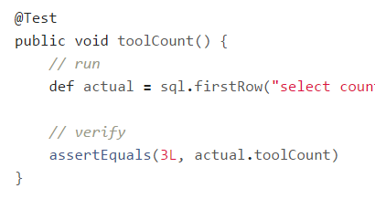
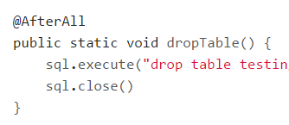
Episode IV: Setup/Teardown

Slide 39
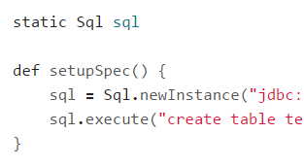
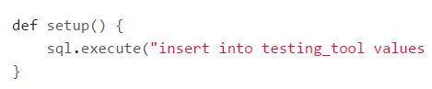
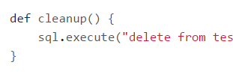
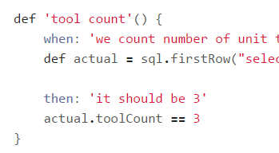
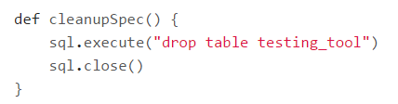
Episode IV: Setup/Teardown

Slide 40
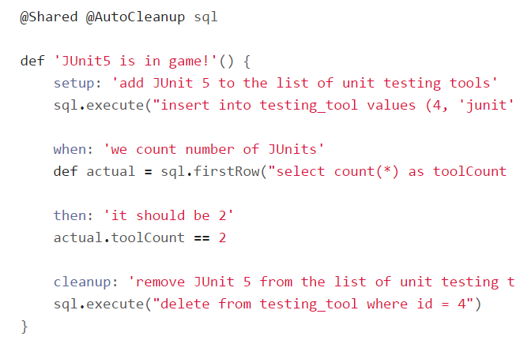
Episode IV: Setup/Teardown

Slide 41
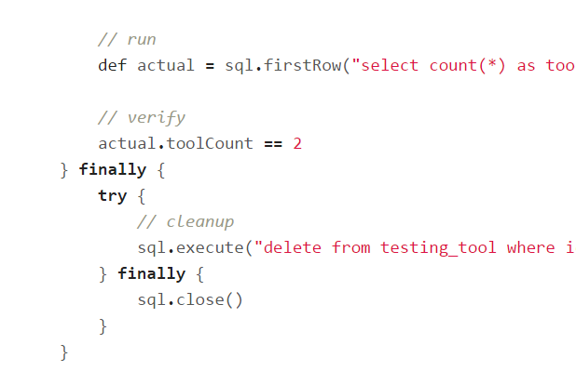

Episode IV: Setup/Teardown

Slide 42





Episode IV: @Shared or static?

Slide 43

Episode V:
Data driven test

Slide 44

Episode V: Data driven test

Slide 45

Episode V: Data driven test

Slide 46

Episode V: Data driven test

Slide 47

Episode V: Data driven test

Slide 48

Episode V: Data driven test

Slide 49

Episode V: Data driven test

Slide 50

Episode V: Data driven test

Slide 51

Episode V: Data driven test

Slide 52

Episode VI:
Exceptions

Slide 53

Episode VI: Exceptions

Slide 54

Episode VI: Exceptions

Slide 55

Episode VI: Exceptions

Slide 56

Episode VI: Exceptions

Slide 57

Episode VI: Exceptions

Slide 58

Episode VI: Exceptions

Slide 59

Episode VI: Exceptions

Slide 60

Episode VI: Exceptions

Slide 61

Episode VI: Exceptions

Slide 62

Episode VII:
Mocks,
Stubs,
Spies

Slide 63



Episode VII: Mocks, Stubs, Spies

Slide 64



Episode VII: Mocks, Stubs, Spies

Slide 65



Episode VII: Mocks, Stubs, Spies

Slide 66


Episode VII: Mocks, Stubs, Spies

Slide 67

Episode VII: Mocks, Stubs, Spies

Slide 68

Episode VIII: Time travel

Slide 69

Episode VIII: Time travel

Slide 70

Episode VIII: Time travel

Slide 71

Episode VIII: Time travel

Slide 72

Episode VIII: Time travel

Slide 73

Episode VIII: Time travel

Slide 74

Episode VIII: Time travel

Slide 75

Episode VIII: Time travel

Slide 76

Episode VIII: Time travel

Slide 77

Episode IX:
Test control

Slide 78

Episode IX: Test control

Slide 79

Episode IX: Test control

Slide 80

Episode IX: Test control

Slide 81

Episode IX: Test control

Slide 82

Episode IX: Test control

Slide 83

Episode IX: Test control

Slide 84

Episode IX: Test control

Slide 85

Episode IX: Test control

Slide 86

Episode IX: Test control

Slide 87

Episode X: Encore

Slide 88

Episode X: Encore

Slide 89

What’s next?
http://spockframework.github.io/spock/docs/1.0/index.html
http://meetspock.appspot.com/
https://github.com/spockframework
Just use it in your projects and enjoy!

Slide 90

Thanks!

